Slide 1
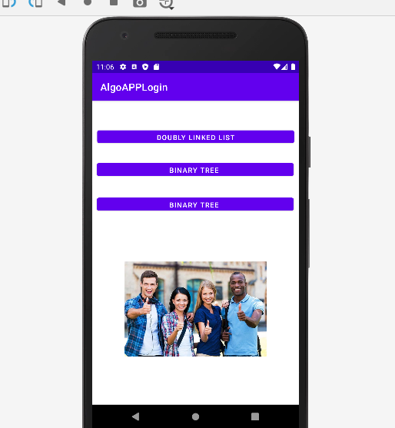

Hello!
I am Hector Santiago
I am here because I would like to present my Android app to you

Slide 2
Algorithms App

Slide 3
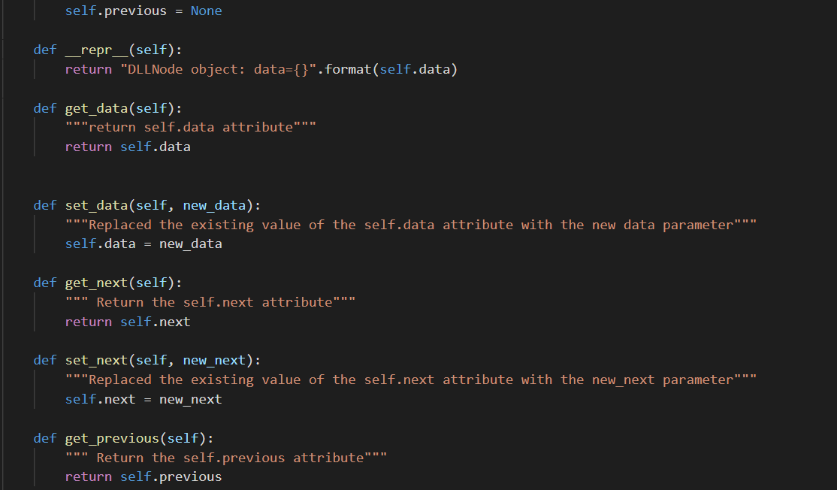
Algorithms

Slide 4
Mobile app quote.
They Time to Learn Time to Study

Slide 5
Concept! To Learn Algorithms.

Slide 6
Mobile App Purpose
A brief overview of the mobile app
The whole purpose of the app is to help you study with algorithms

Slide 7

Mobile App Goal
Purpose (With this app we don’t have to go every where looking for places where algorithms are located.)

Slide 8

Target Audience: Students and Everyone that wants to learn Algorythms

Slide 9

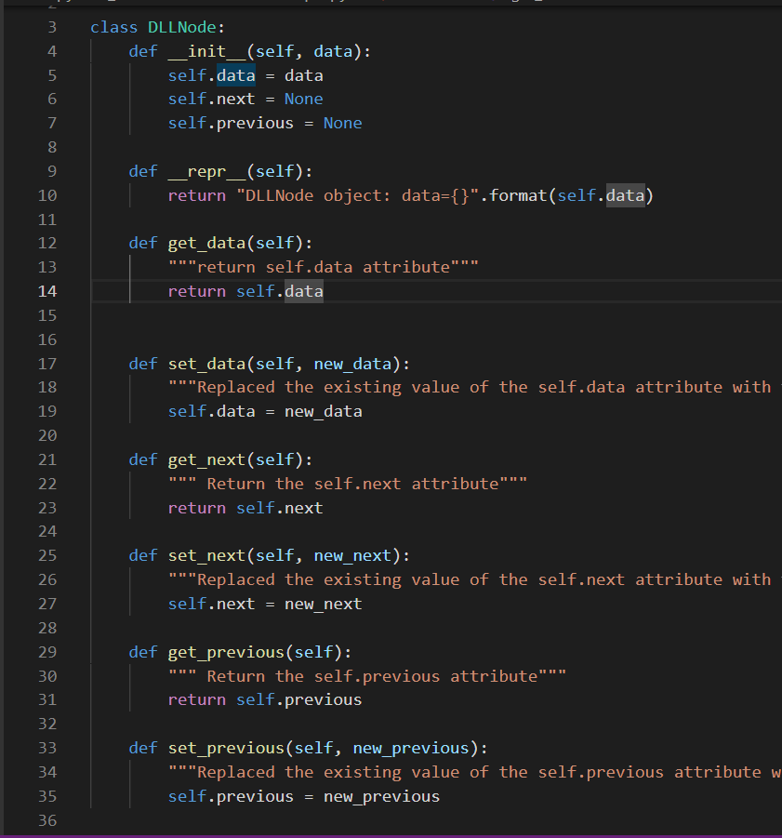
Mobile App Features
The App shows you algorithms examples when you need them the most.
Example of a Double Link List Code

Slide 10
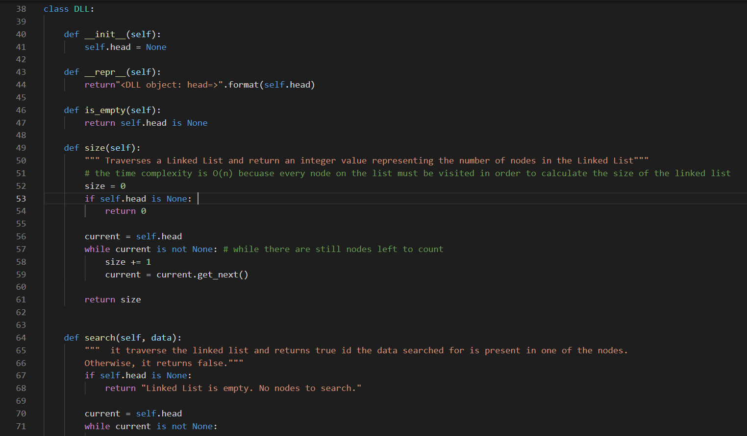
Features The app shows you the algorithm that you want to see.

Slide 11
Competition Mapping
Algo Expert.io
Leetcode
Hacker Rank

Slide 12
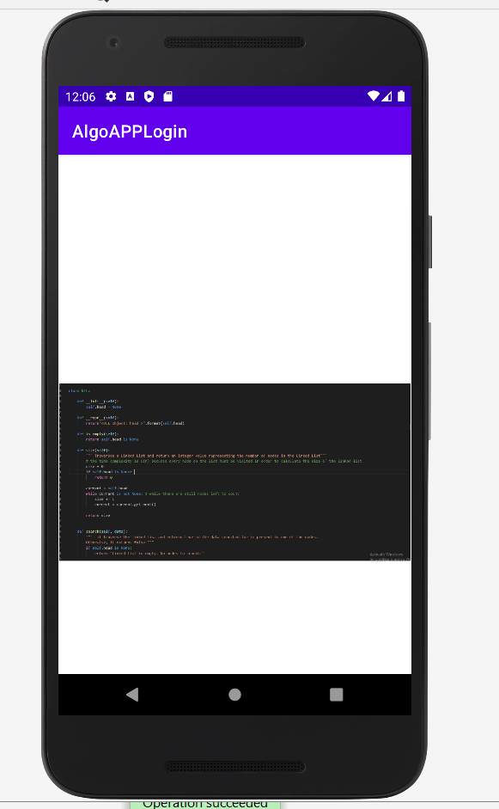
Risks/Weaknesses
In order to fully develop the application we are going to need team members to help with the code base.

Slide 13

Development process
The code gets submitted to me then I will test it, after it is tested then a button for the algorithm is created as well as an activity linking that button to the algorithm. The App can be deployed through the app store.

Slide 14
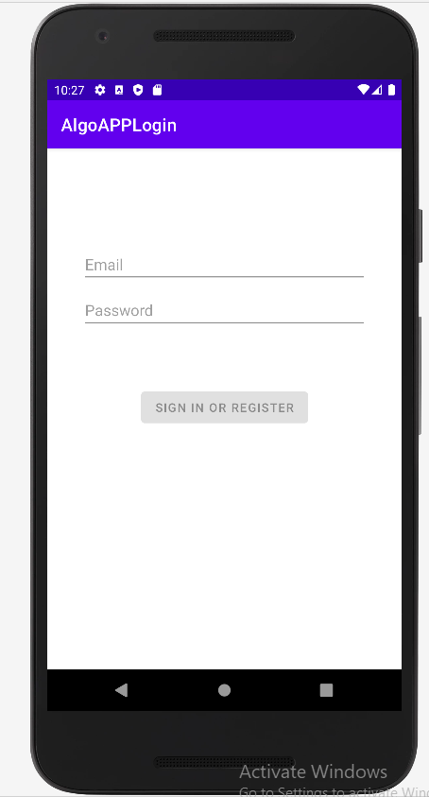
Android project App starts with a login screen.

Slide 15
Android project
Once you log in it takes you to
the main window in which
You can choose the algorithm
of your choice.

Slide 16
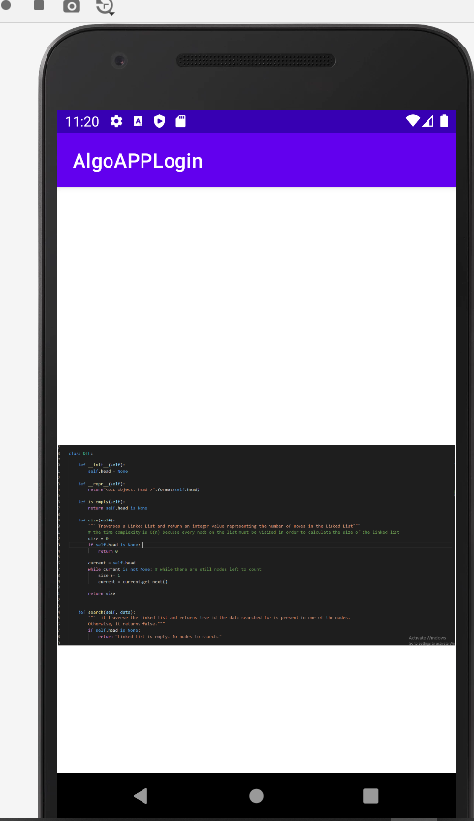
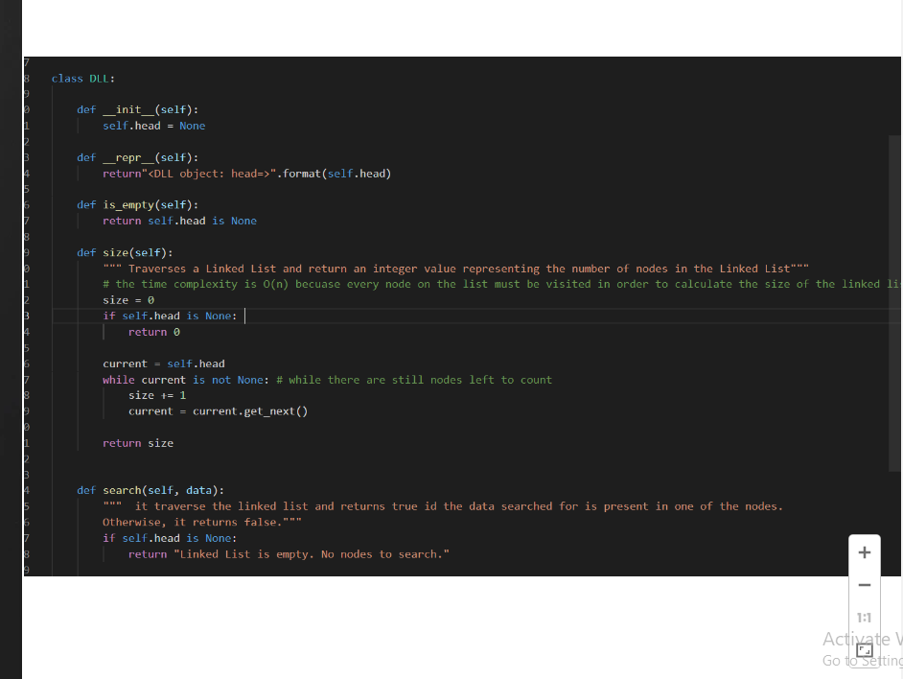
Android project
Example of the Doubly Linked List Zoomed in the Android Phone

Slide 17

Thanks!
Any questions ?
You can find me at
hecsan9634@students.edu

Slide 18
Icons are editable shapes.
This means that you can:
You can use any of the icons on the left (just copy and paste)
Resize them without losing quality.
Change line color, width and style.
Isn’t that nice? :)
Examples:

